Slide 1
NRC CAFE report
Comments on APPENDIX A “Dissent on Safety Issues”
Dr. Leonard Evans
International Traffic Medicine Association
Notes:
Comments based largely on “Causal influence of car mass and size on driver fatality risk” Am J Pub Health 91; 1076-81:2001
http://www.TrafficMedicine.org
general information, membership application form
http://www.JTrafficMedicine.com
Journal of Traffic Medicine, including author instructions
http://www.ITMA2002.com
World Congress, Cairo, Egypt, 22-25 Sep. 2002
You can view this presentation at
http://www.scienceservingsociety.com/CAFE%20TRB%20Presentation.ppt

Slide 2
Page A-1 of dissenting Appendix alleges that there are
“two logical fallacies”
“The second fallacy arises from failing to adequately account for confounding factors ………... Because the driver is generally a far more important determinant of crash occurrences than the vehicle ….”
(direct quotes from Appendix in white italics – comments in this font added to make slide presentation more self-contained)
Comment: Central factor in traffic safety is indeed driver behavior, but claim in Appendix does not follow from this

Slide 3
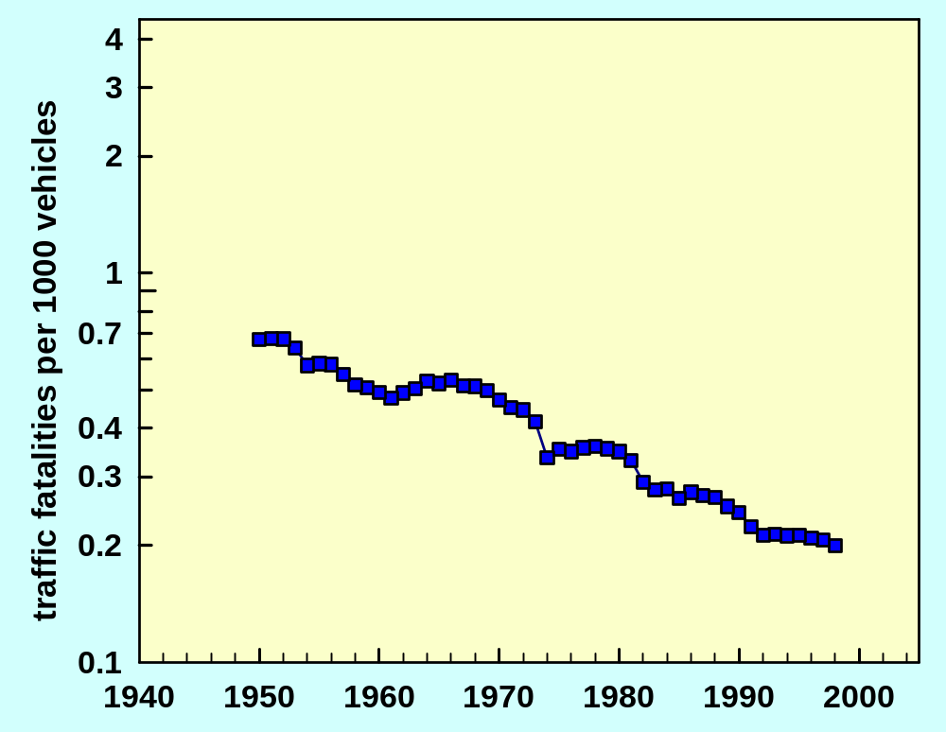

Slide 4
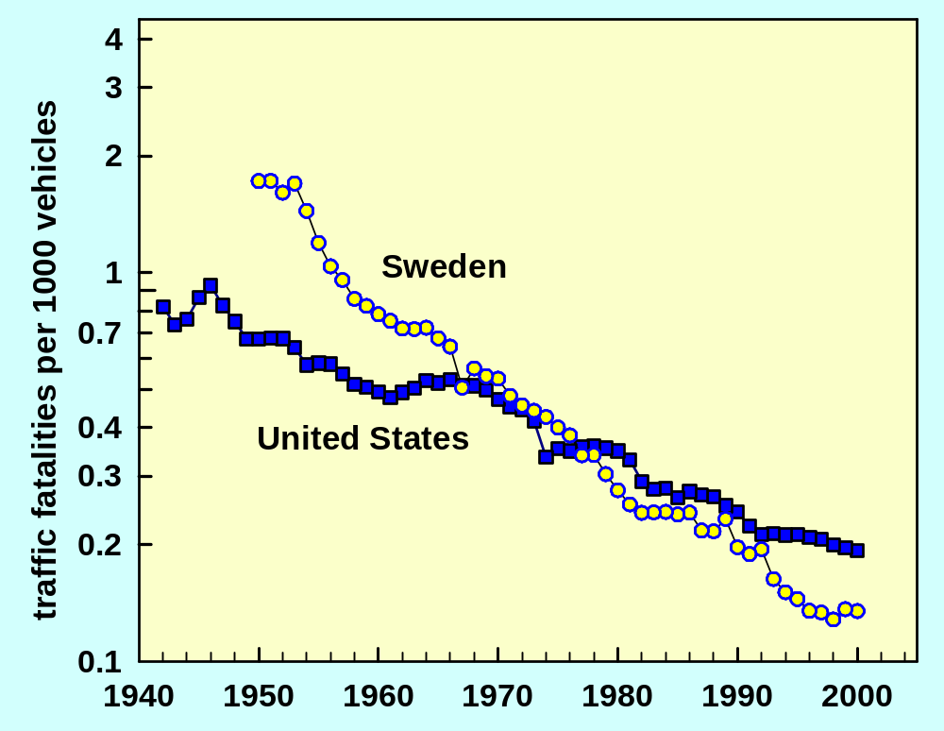

Slide 5
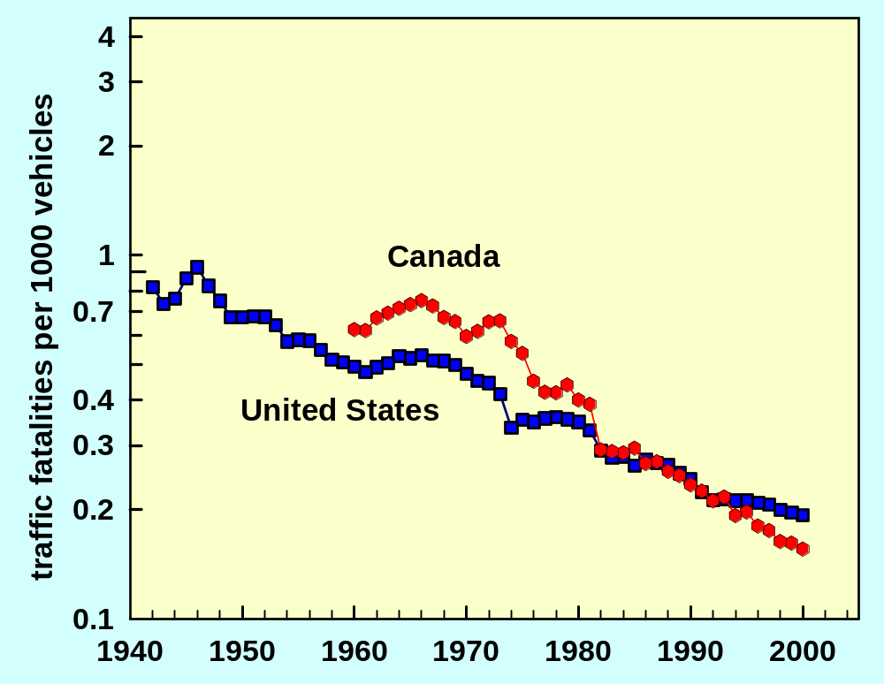

Slide 6
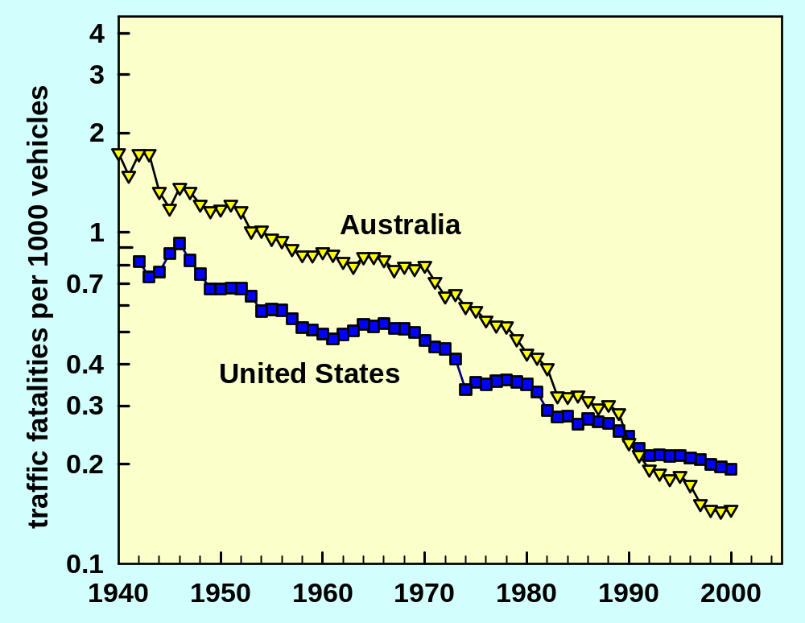

Slide 7
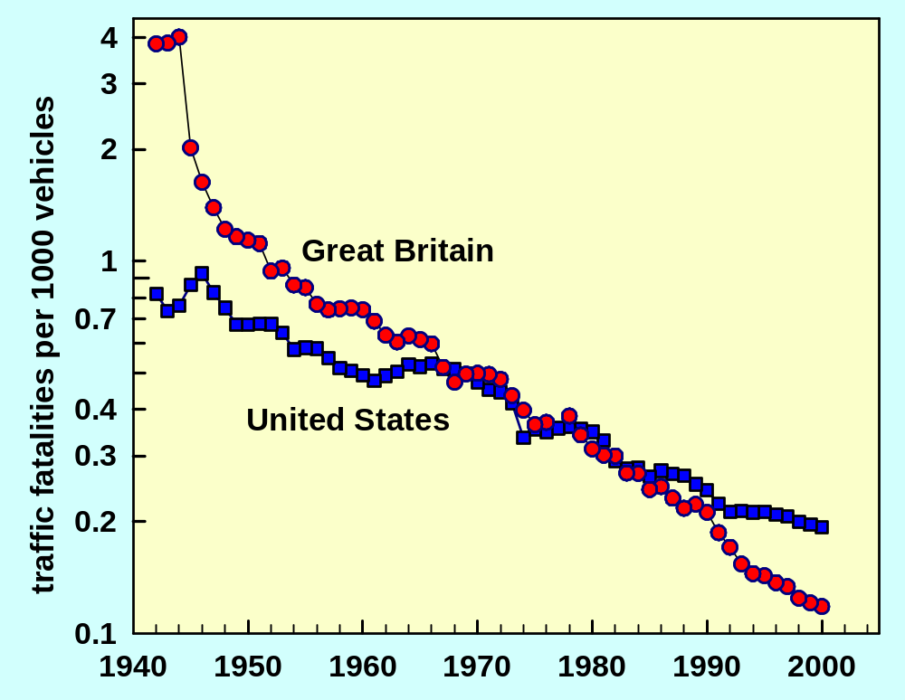

Slide 8
If US had matched other countries, 200,000 fewer Americans would have been killed in last two decades
Driver behavior is overwhelmingly the major factor
All of vehicular factors relatively unimportant compared to driver behavior
Vehicle mass is largest vehicle factor
Effect of CAFE only a few percent

Slide 9
Can effects of important smaller factors be reliably determined in face of enormous driver behavior effects?
Yes, in many cases
Regression analyses tool of last resort

Slide 10
R=(Fatalities in Lighter Car)/(Fatalities in Heaver Car)
20
15,356 unbelted drivers killed in
front-impact two car-crashes
10
μ
3.58
7
R =
5
R
4
3
2
FARS 1975-1998
1
1
1.1
1.2
1.3
1.4
1.5
1.6
1.8
2.0
2.2
μ = (Mass of Heavier Car)/(Mass of Lighter Car)

Slide 11
(Accompanied Driver Risk) / (Lone Driver Risk)
10
FARS 1975-1998
5
2
3.36
R = 0.855
μ
1
Intercept
= -0.145 ± 0.023
0.5
0.2
3692 Unbelted Drivers
Killed in Front-Impact
Two-Car Crashes
0.1
0.5
0.6
0.7
0.8
0.9
1
1.2
1.5
2
Mass Ratio,
μ

Slide 12
Page A-1 First of the two logical fallacies
In the dissenting Appendix it is alleged that it is a fallacy that reducing mass of all vehicles will increase risks in collisions between vehicles
Comment: Data consistently show “no fallacy”

Slide 13
Risk, R , When Cars of Similar Mass, M, Crash Into Each Other
MM
R =
1820
MM
M
FARS
2.5
NY
NC
GER Urban
2.0
GER Rural
R
MM
1.5
1.0
600
800
1000
1200
1400
1600
1800
2000
Mass, M, of Each Car, kg

Slide 14
Addition of 165 pound passenger reduces driver fatality ratio by -(14.5 ± 2.3)%
Model shows this decomposes into
 7.5% risk reduction to accompanied driver
 8.1% risk increase to lone driver
 0.3% average risk increase per driver
This is “pure mass effect”
If, instead, a car is replaced by a car 165 pounds heavier, model shows
 11.3% risk reduction to driver of heavier/larger car
 6.9% risk increase to driver of lighter/smaller car
 2.2% average risk decrease per driver

Slide 15
Page A-13 Opening sentence of SUMMARY
“The relationship between vehicle weight and safety are complicated and not measurable with any reasonable degree of certainty at present,”
Comment: In the context of what is known about traffic, it is hard to imagine a more unreasonable claim

Slide 16
Vehicle mass and size have a better established, and better quantified, influence on safety than any other factor, including -
 Speed limits
 Safety belts
 Belt wearing laws
I am unaware of any safety relationship that has not attracted constituencies of enthusiastic deniers
Vehicle size effects consistently observed using many data sets and many analysis methods
Many results related to basic physical laws
In common with all aspects of traffic safety (and everything else) more is not known than is known

Slide 17
What Is Known Beyond Reasonable Doubt
Two-vehicle Crashes
Replacing a vehicle by one that is larger and heavier
 Reduces risk to its occupants
 Increases risk to occupants in other vehicle
Whether the net effect reduces or increases risk depends on the specific masses involved
For vehicle fleet effect is too small to be estimated reliably
However, we can be confident that the net effect is, at the very most, a small increase in net risk (it is more likely a decrease)

Slide 18
What Is Known Beyond Reasonable Doubt
Single-vehicle Crashes (about half of all fatalities)
Greater vehicle mass reduces injury severity when real-world objects are struck, as required by Newtonian mechanics
Greater size reduces injury severity by providing larger crush distance which reduces forces on occupants
Larger size is associated with larger track width, which reduces rollover risk
Clear cut single-vehicle effects overwhelm any possible uncertainties in the two-vehicle case
Net effect is unambiguous – reducing weight increases casualties

Slide 19
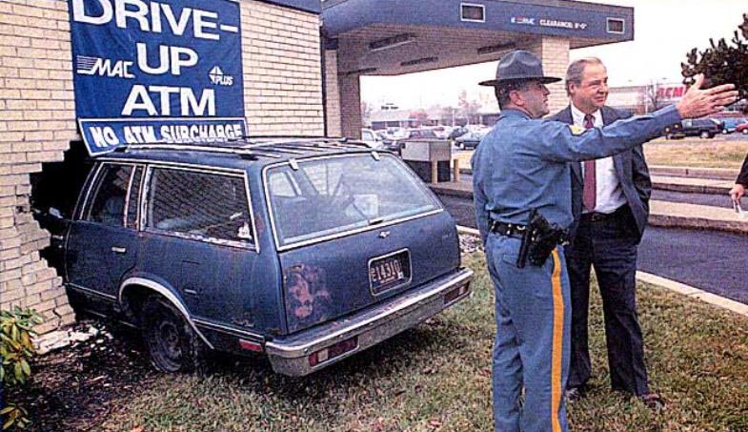
READER SIGHTINGS
Car and Driver, April 1998
Comment: If small/light vehicle, wall would be fine, but driver would be dead or injured
Seeking a more personal relationship with his bank teller, a Delaware driver passed up the more traditional window service
Photographed by Don Blake of the Delaware News Journal

Slide 20
Conclusions
CAFE has caused, and is causing, increased fatalities
Higher CAFE will generate additional fatalities
This does not necessarily mean we should not have higher CAFE –
We all support lots of policies that we know kill people
Role of technical community is to provide political
process with technical information
Notes:
Comment: The technical community has a duty to inform the political process that not having a hospital at the end of every street increases fatalities, and policies that lead to lighter/smaller vehicles increase fatalities. The physical world is what it is, and does not change depending on the political and philosophical beliefs of those investigation it. It is the legitimate role of the political process to decide based on correct information.

